Slide 1
Group 20 Level 4-5
imdcgd111 Group Project
imdcgd214 Managing Games Production
Ross Warren (S176778)
Max Carter (s175573)
Jack Fuller (s176802)
Jake Seaman (s183883)

Slide 2
Brief
MC
Constraints
2D Environment
Physics based mechanic
Adversarial
Played on a single device
Symmetric
Simple rules

Slide 3

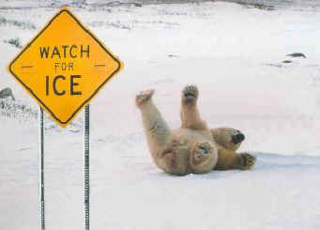


Concepts and design ideas
JS
Buoyancy
Friction
Gravity
Light

Slide 4
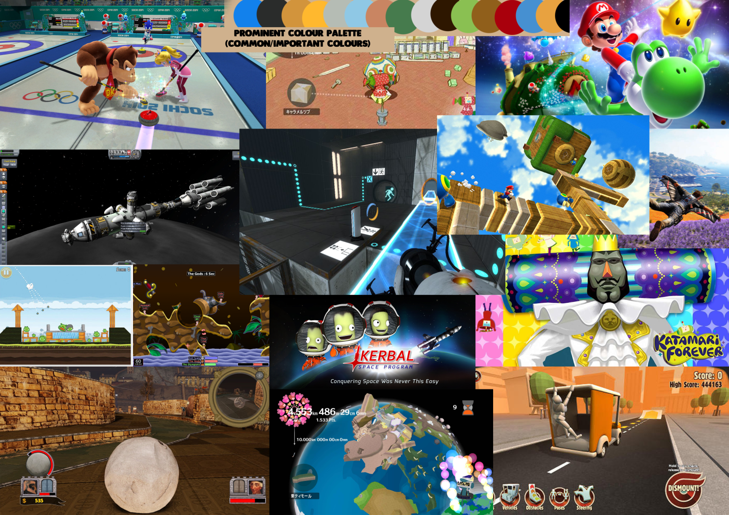
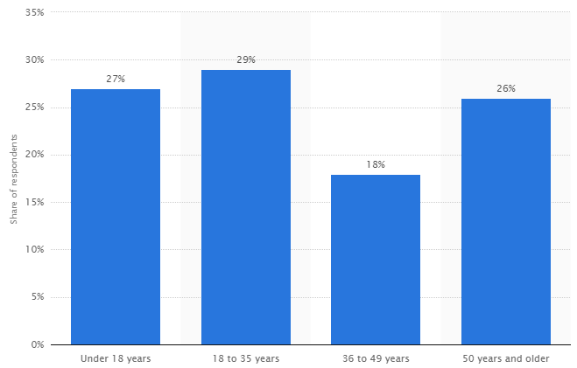
Research + Demographic
JF
Established demographic of mostly males aged 12 – 35
Colourful
Vibrant
Minimalist or smooth
https://www.statista.com/statistics/189582/age-of-us-video-game-players-since-2010/

Slide 5
Old Mechanic
RW
Friction
Twitch

Slide 6
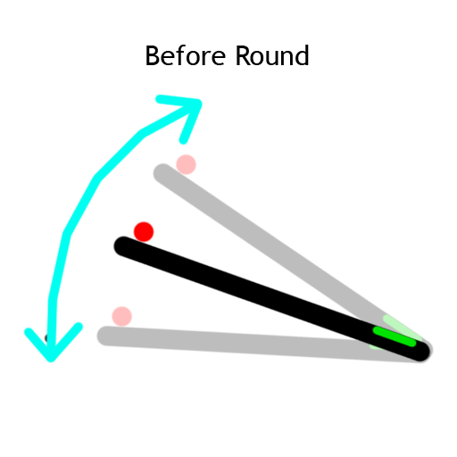
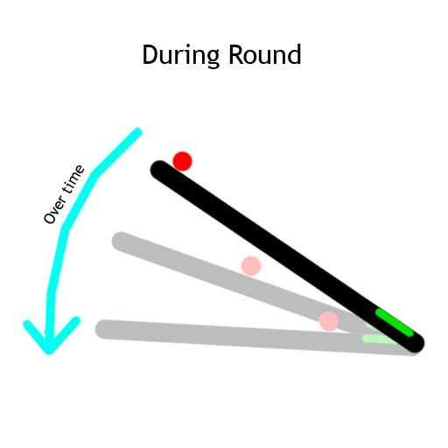
New Mechanic - Angling
MC
Friction
Unpredictability
Twitch mechanic removed
Notes:
We are currently working on playtesting this to see if the players enjoy it and to see if it fits our game

Slide 7
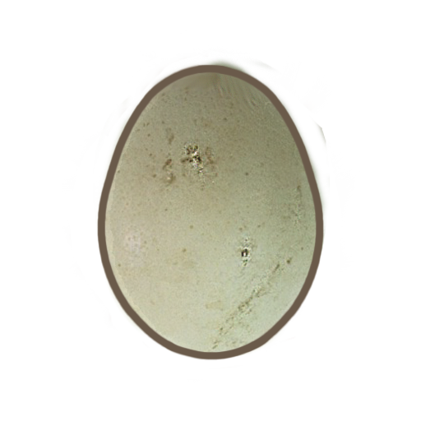
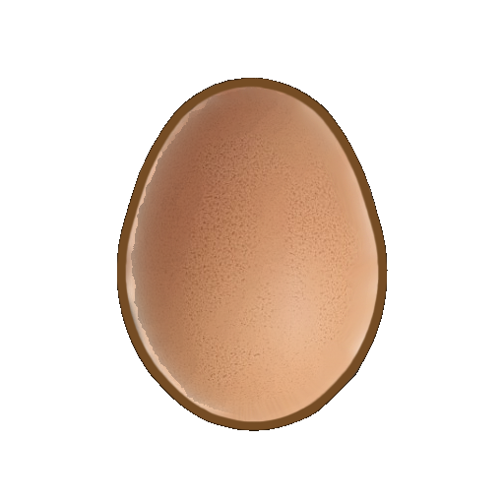
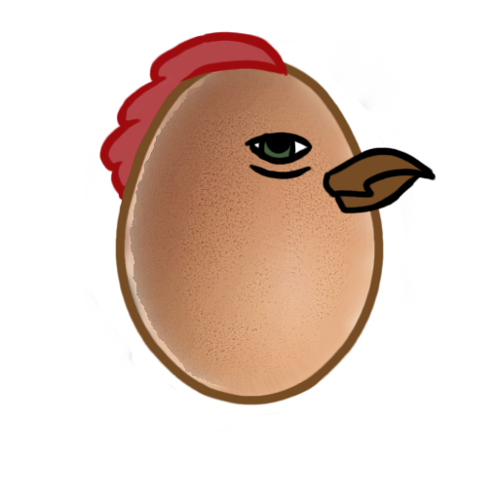

Art assets
RW

Slide 8

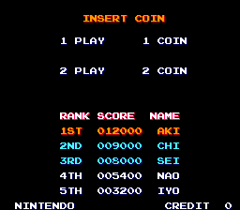
Replay Value
JF
Trophies
High Scores

Slide 9
Emails and Jira
RW

Slide 10
RW
Questions?

